Slide 1


Object Oriented Programming
Introduction
ILIA STATE UNIVERSITY
Paata Gogishvili
Doctor of Informatics
Associate Professor
School of Technology
March 01, 2024
Faculty of Business, Technology and Education

Slide 2
Lecture Topics
Introduction to OOP
About Java
JVM, JRE, JDK
Java syntax.
ILIA STATE UNIVERSITY

Slide 3
What is OOP
As the name suggests, Object-Oriented Programming refers to languages that use objects in programming.
ILIA STATE UNIVERSITY

Slide 4
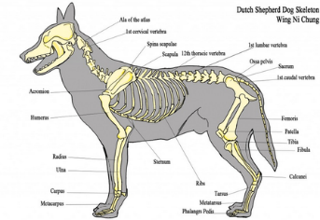


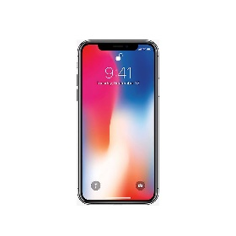
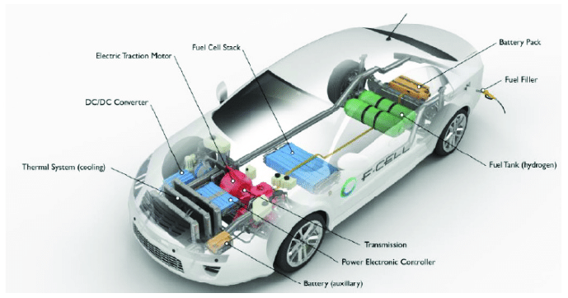
What is the Object
The object is what we think under the object in real life.
ILIA STATE UNIVERSITY

Slide 5
Why we need objects in programming
Once we need them in real life, we need them in programming as well. The main benefits from object are:
Encapsulation
Abstraction
Inheritance
Polymorphism
ILIA STATE UNIVERSITY

Slide 6
Are there other paradigms besides OOP?
Step by step;
Functional programming;
Logical programming;
…
ILIA STATE UNIVERSITY

